Slide 1
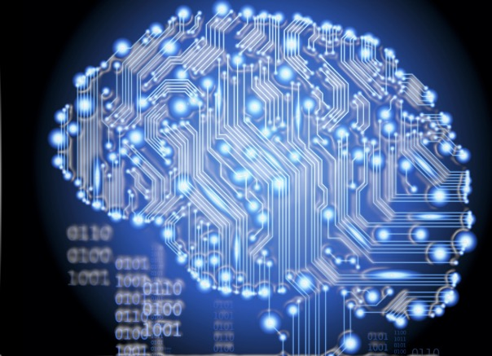
ARTIFICIAL INTELLIGENCE M.DRUMARE

Slide 2
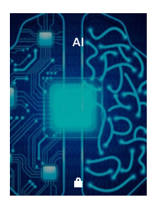
ON FLIPBOARD
http://flip.it/IakG7_

Slide 3
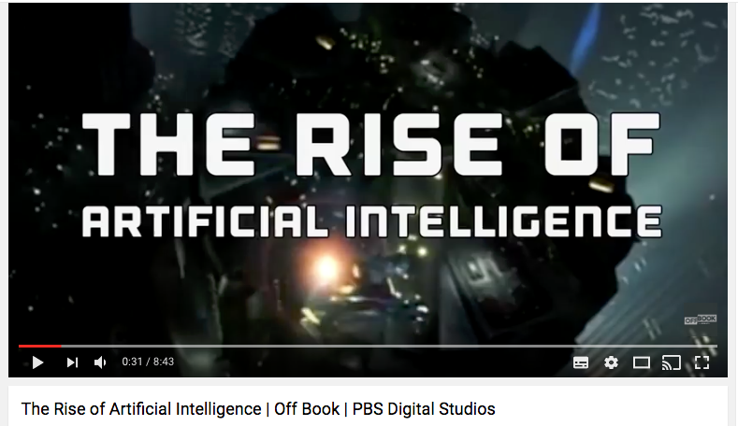

Slide 4
WHAT ?

Slide 5
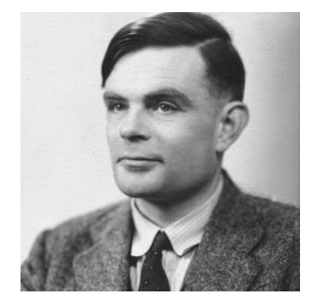
AI AS AN OLD DREAM : ALAN TURING (1950)
« Alan Turing’s famous 1950 paper, “Computing Machinery and Intelligence.” Turing’s paper posed the question: “Can machines think?” It also proposed a test for answering that question and raised the possibility that a machine might be programmed to learn from experience much as a young child does. »

Slide 6
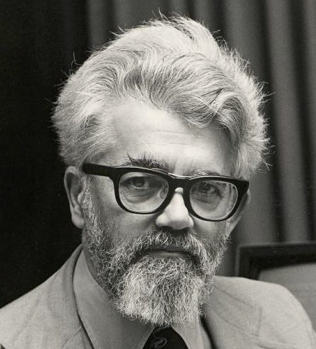
AI FIRST DEFINITION : JOHN MACCARTHY (1954)
« Every aspect of learning or any other feature of intelligence can in principle be so precisely described that a machine can be made to simulate it. An attempt will be made to find how to make machine use language, form abstractions and concepts, solve kinds of problems now reserved for humans, and improve themselves. »

Slide 7
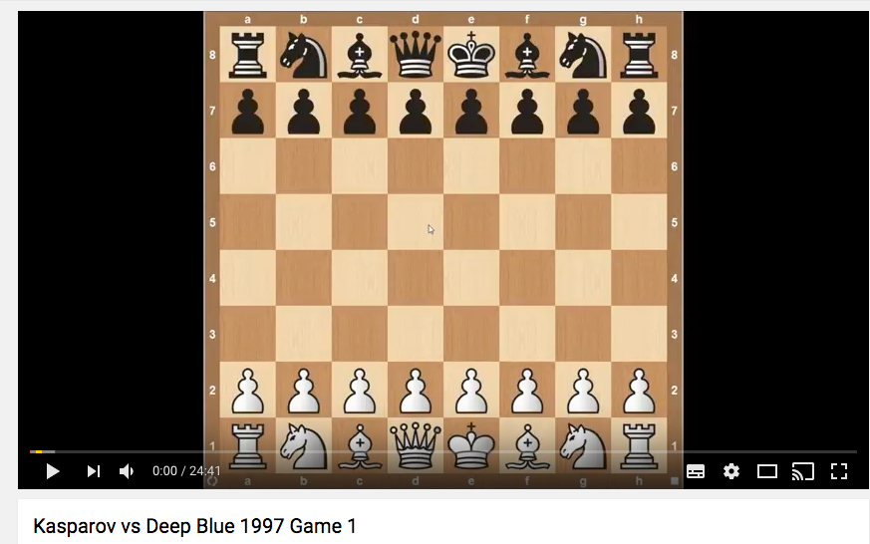
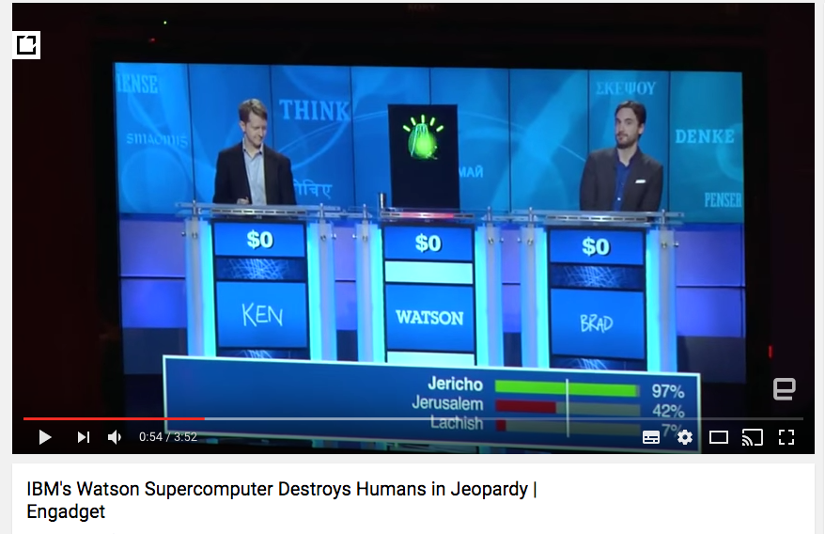

AI RENEWAL : DEEP BLUE AND WATSON (IBM)
It wasn’t until the late 1990s that research progress in AI began to accelerate.
An early milestone was the 1997 victory of IBM’s chess-playing computer Deep Blue over world champion Garry Kasparov.
Watson’s victory in the TV game show “Jeopardy.

Slide 8
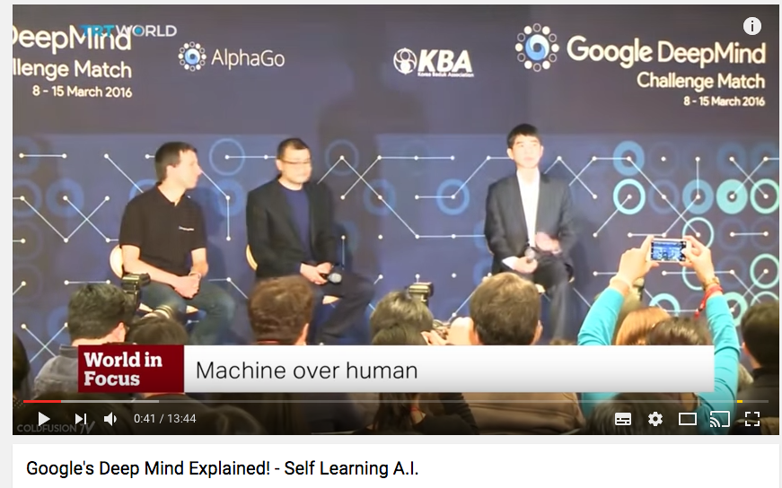
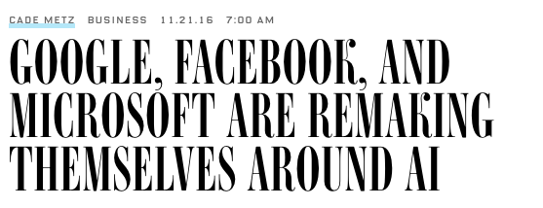
AI BOOMING : GOOGLE, FACEBOOK, MICROSOFT
« Machine learning (a subfield of AI) is a core. Transforming the way by which we’re rethinking how we’re doing everything »
2016, Google Chief Executive Officer

Slide 9
NO SINGLE AI DEFINITION
Experts offer differing taxonomies of AI problems and solutions:
Systems that think like humans (e.g., cognitive architectures and neural networks).
Systems that act like humans (e.g., natural language processing; knowledge representation, automated reasoning, and learning).
Systems that think rationally (logic solvers, inference, and optimization).
Systems that act rationally (e.g., intelligent software agents and embodied robots that achieve goals via perception, planning, reasoning, learning, communicating, decision-making, and acting).

Slide 10
NO SINGLE AI DEFINITION
Frank Chen broke down the problem space of AI into five general categories: logical reasoning, knowledge representation, planning and navigation, natural language processing, and perception.
What is important is that a core objective of AI research and applications over the years has been to automate or replicate intelligent behavior.

Slide 11
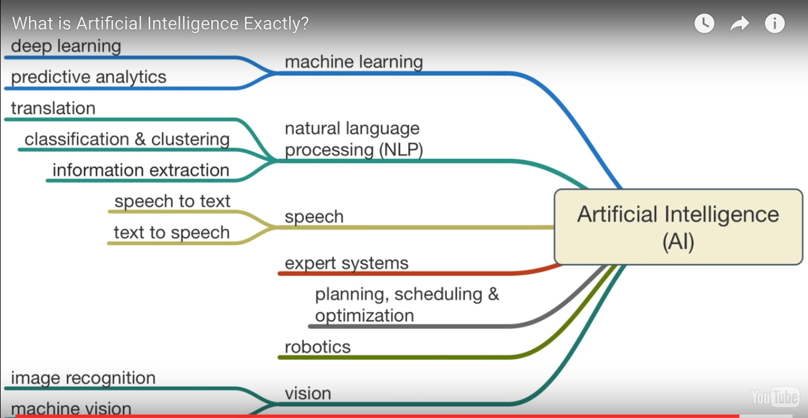
SUBSET OF INTELLIGENCE: TYPE OF AI

Slide 12
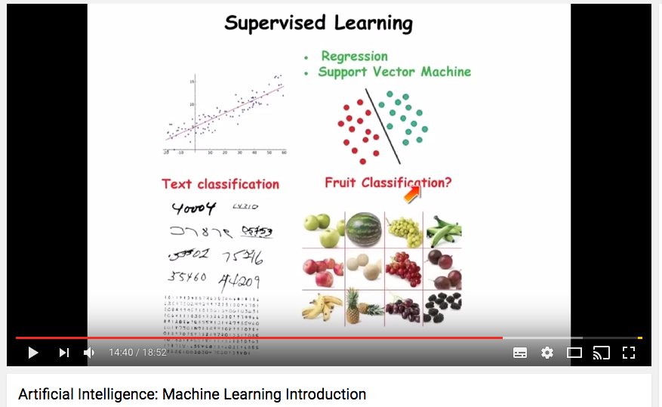
MACHINE LEARNING
Machine learning is one of the most important technical approaches to AI and the basis of many recent advances and commercial applications of AI.
Modern machine learning is a statistical process that starts with a body of data and tries to derive a rule or procedure that explains the data or can predict future data.

Slide 13
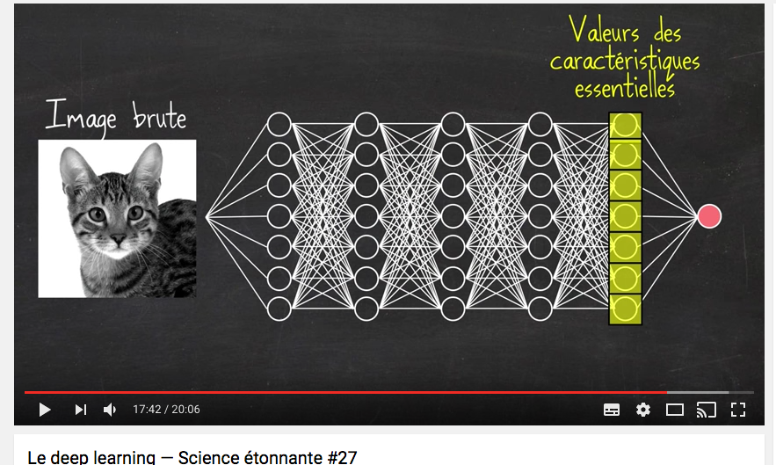
DEEP LEARNING
In recent years, some of the most impressive advancements in machine learning have been in the subfield of deep learning, also known as deep network learning.
Deep learning uses structures loosely inspired by the human brain, consisting of a set of units (or “neurons”). Each unit combines a set of input values to produce an output value, which in turn is passed on to other neurons downstream.

Slide 14
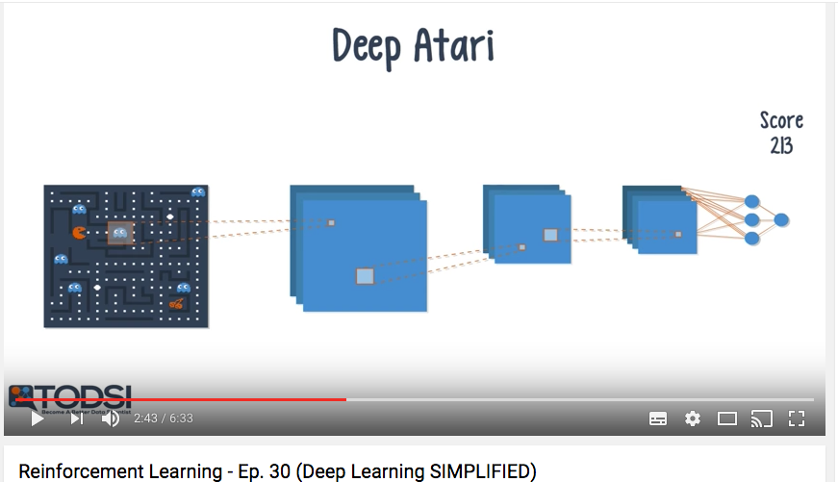
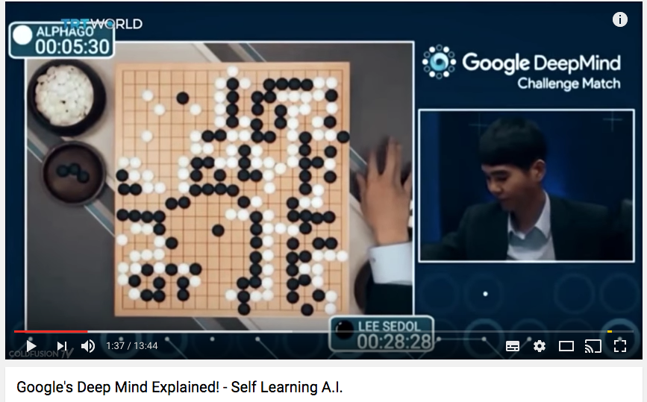
DEEP REINFORCEMENT LEARNING
Reinforcement Learning has started to receive a lot of attention in the fields of Machine Learning and Data science.
In January of 2016, a team of researchers from Google built an AI that beat the reigning world champion of the board game Go.
This AI, AlphaGo, utilizes reinforcement learning in order to discover new strategies

Slide 15
AUTONOMY AND AUTOMATION
Autonomy refers to the ability of a system to operate and adapt to changing circumstances with reduced or without human control. For example, an autonomous car could drive itself to its destination.
Automation occurs when a machine does work that might previously have been done by a person. The term relates to both physical work and mental or cognitive work that might be replaced by AI.

Slide 16
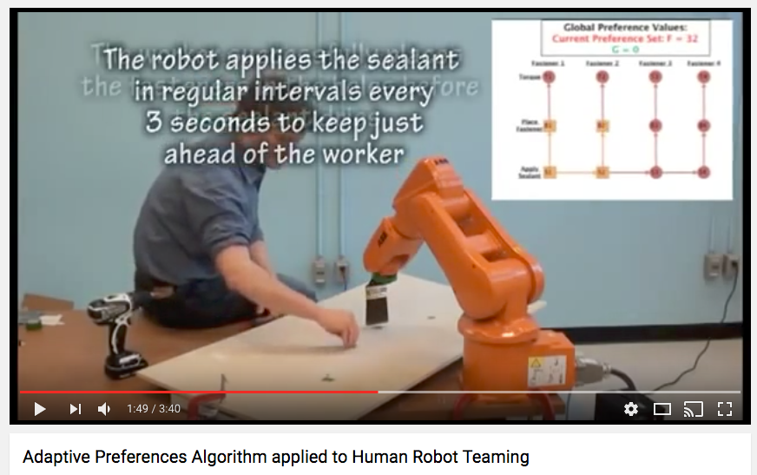
HUMAN-MACHINE TEAMING
In contrast to automation, where a machine substitutes for human work, in some cases a machine will complement human work.
In one recent study, given images of lymph node cells, and asked to determine whether or not the cells contained cancer, an AI-based approach had a 7.5 % error rate, where a human pathologist had a 3.5 % error rate; a combined approach, using both AI and human input, lowered the error rate to 0.5 %

Slide 17
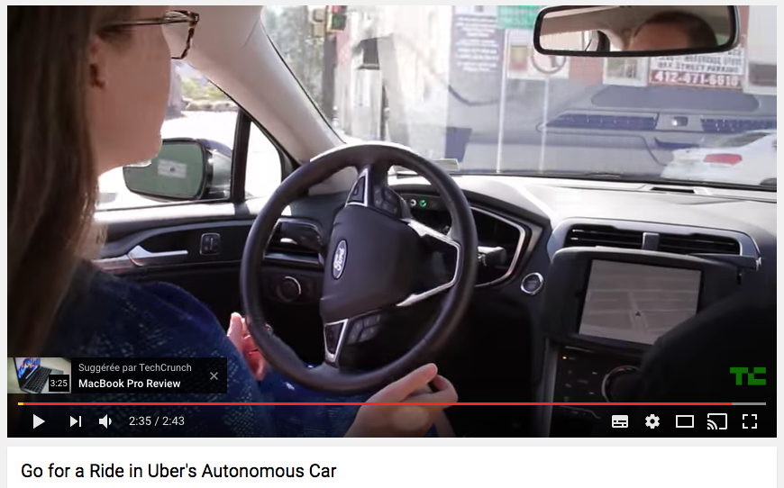
AUTONOMOUS CAR
New cars have AI-based driver assist features like self-parking and advanced cruise controls that keep a car in its lane and adjust speed based on surrounding vehicles.
Experimental fully automated cars monitored by humans can already be seen driving on the roads.
A well-designed system of automated vehicles able to predict and avoid collisions may also significantly reduce transportation-related emissions and energy consumption.
$3.9 billion investment in 2017 by the US Department of Transportation technologies.

Slide 18
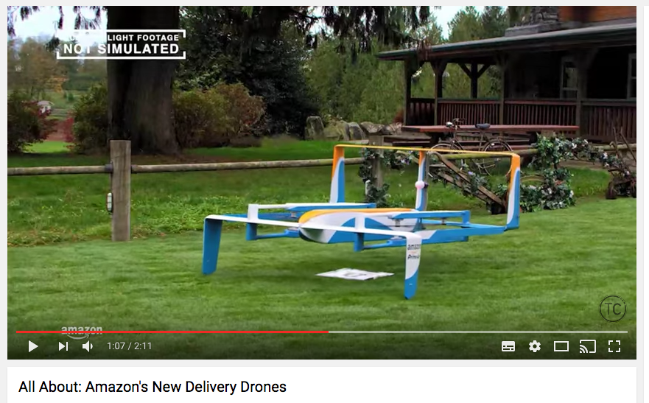
UAS (Unmanned Aircraft Systems)-DRONE
Number of UAS registered for commercial use will exceed 600,000 by August 2017.
More than $13.6 billion of economic value created by UAS in the first three years of integration, with sustainable growth predicted to follow.
Commercial drone industry could generate more than $82 billion for the U.S. economy and create more than 100,000 new jobs over the next 10 years.

Slide 19
AI IS EVERYWHERE
Public- and private-sector investments in basic and applied R&D on AI have already begun reaping major benefits for the public in fields as diverse as
Health care
Resarch.
Transportation.
Environment.
Criminal justice
Defense.
Social Issues (unemployment, poverty, education)
Economics( e-commerce, finance, marketing), etc….

Slide 20
AI DRIVES THE INSIGHT REVOLUTION-FORRESTER
Across all businesses, there will be a greater than 300% increase in investment in artificial intelligence in 2017 compared with 2016.
Through the use of cognitive interfaces into complex systems, advanced analytics, and machine learning technology, AI will provide business users access to powerful insights never before available to them.
It will help, says Forrester, “drive faster business decisions in marketing, ecommerce, product management and other areas of the business by helping close the gap from insights to action.”

Slide 21
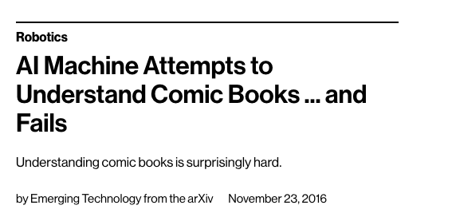
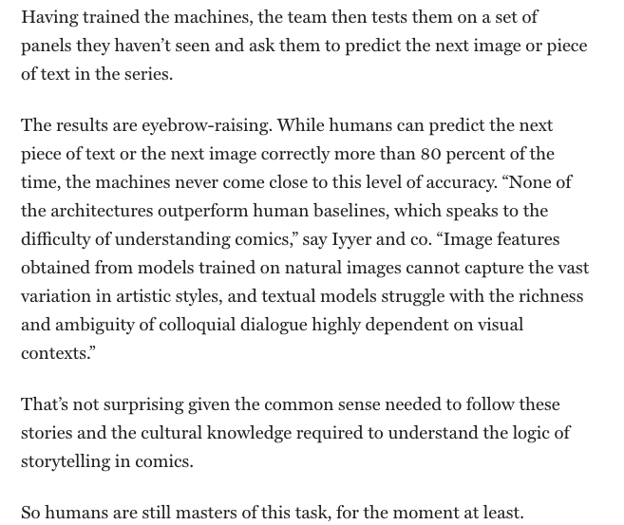
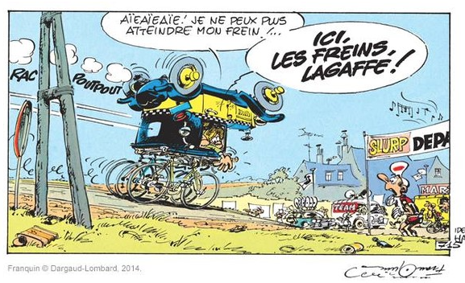

AI LIMITATIONS
Bias datasets.
Opacity of AI algorithms.
Safety and lack of control.
Complexity of the real life : the system might have a superhuman ability to detect dirt and optimize its mopping strategy, yet not know to avoid swiping a wet mop over an electrical outlet.
Complexity of the fiction.

Slide 22
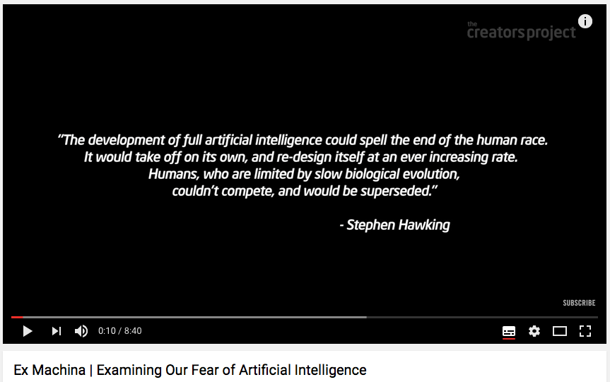
FEARS ABOUT AI
People have long speculated on the implications of computers becoming more intelligent than humans.
If computers could exert control over many critical systems, the result could be havoc, with humans no longer in control of their destiny at best and extinct at worst.
The best way to build capacity for addressing the longer-term speculative risks is to attack the less extreme risks already seen today, such as current security, privacy, and safety risks.

Slide 23
HOW ?

Slide 24
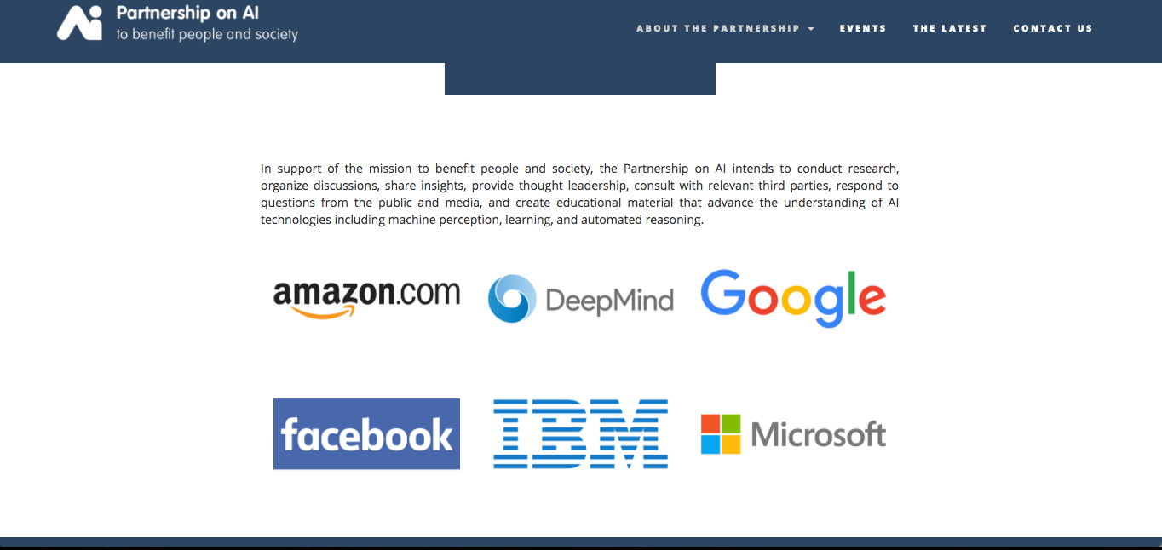
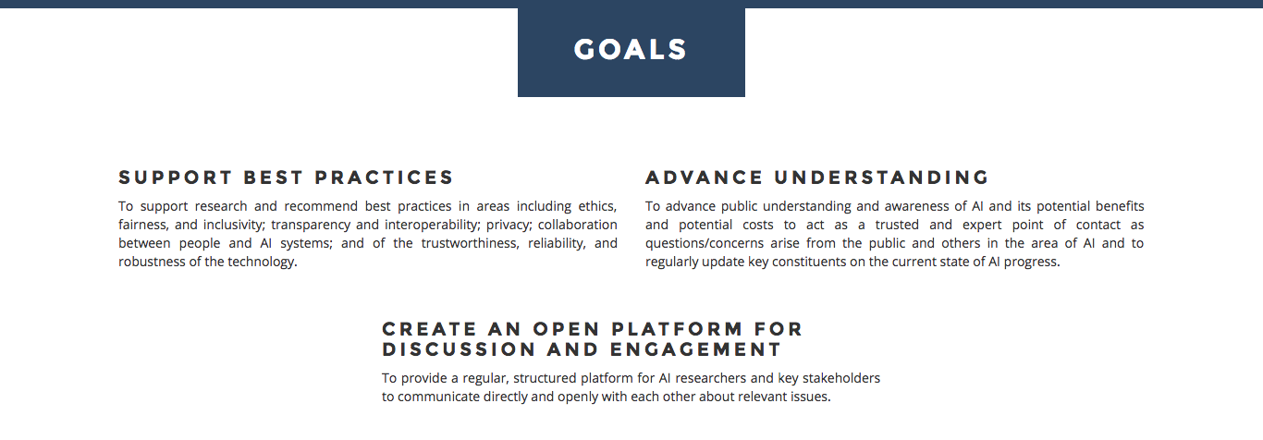
PARTNERSHIP

Slide 25

ACQUISITION : STARTUPS AND EXPERTS
In 2013, Facebook created a lab dedicated to AI and recruited deep learning expert Yann Lecun.
In 2014, Google bought the startup Deepmind for more than $500M.
In 2015, Vocal IQ (voice recognition) and in 2016 Apple bought the AI startup Emotient.
In 2016, Salesforce.com adquired MetaMind, startup specialized in deep learning (answer a question that are in natural language).

Slide 26

ACQUISITION : STARTUPS AND EXPERTS
Einstein is a platform that adds artificial intelligence and machine-learning capabilities to Salesforce core products.
To build Einstein, Salesforce spent about $650 million acquiring dozens of startups in the artificial intelligence and machine-learning space over the past two years.
That has helped the company quietly put together an army of 175 data scientists, and on Sunday it unveiled the launch of a new research lab called Salesforce Research as well.

Slide 27
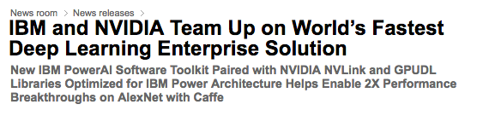
ALLIANCES : IBM AND NVIDIA
In 2016 : IBM and Nvidia team up to launch a new server purpose-built for machine learning
Together with Nvidia, IBM built this new system specifically for artificial intelligence, machine learning and advanced analytics use cases.
The new server uses two of IBM’s POWER8 CPUs and four of Nvidia’s Tesla P100 GPU accelerators.

Slide 28
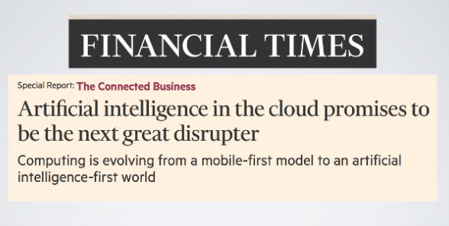
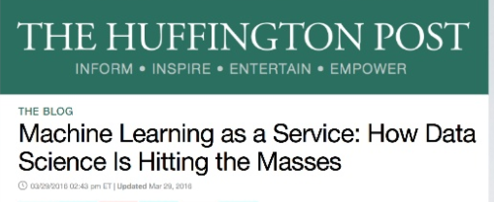
LOOK AT THE CLOUD : MLaaS
The most recent change has involved a combination of cloud and mobile, with smartphones acting as the delivery mechanism for services in the cloud.
This is starting to evolve into the next thing : the combination of artificial intelligence (AI) and the cloud.
These new ML providers comprise a predictive analytics industry worth anything between $5-10 billion.
There’s something for everyone: a developer who wants to build predictive analytics into their application, a customer success team that needs to know which accounts are likely to churn, a data scientist looking to run models on faster and cheaper infrastructure.

Slide 29
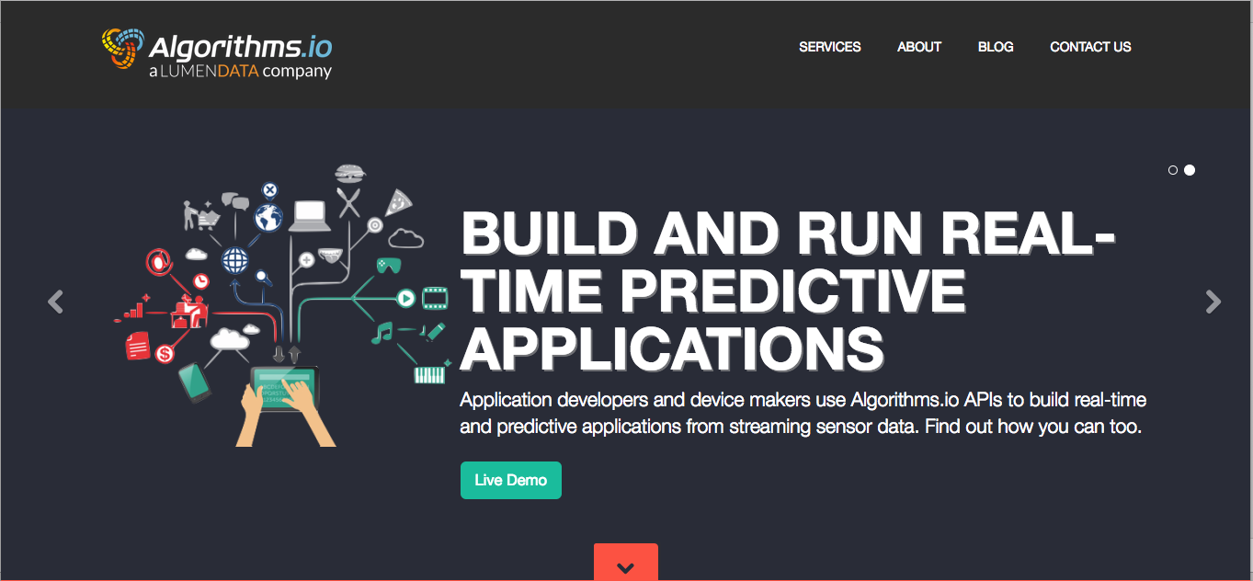

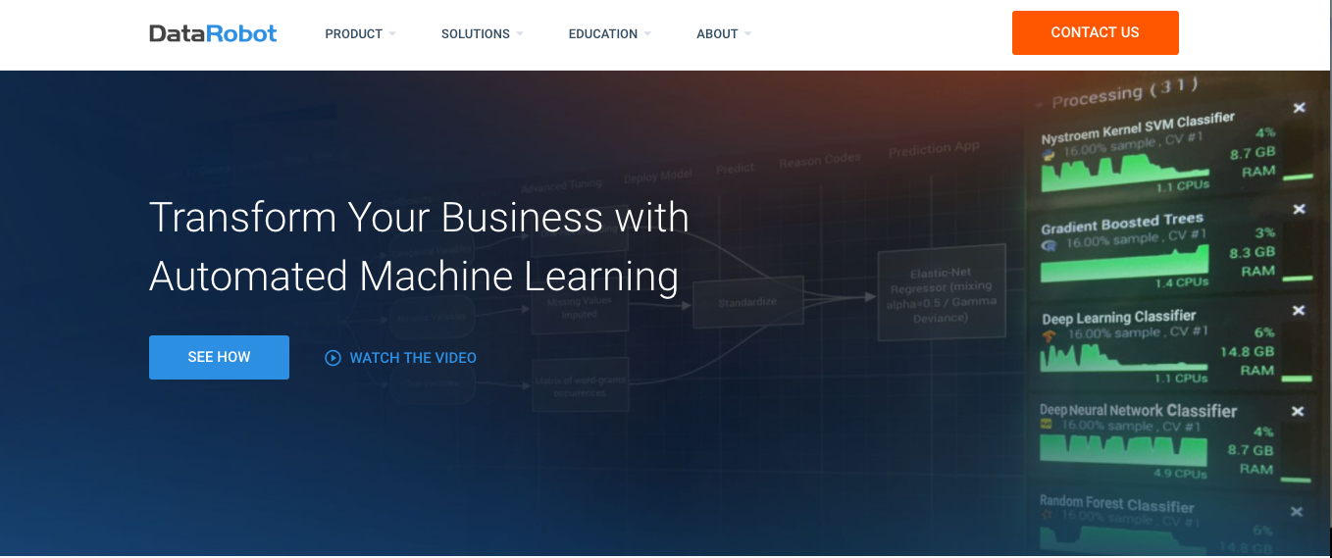

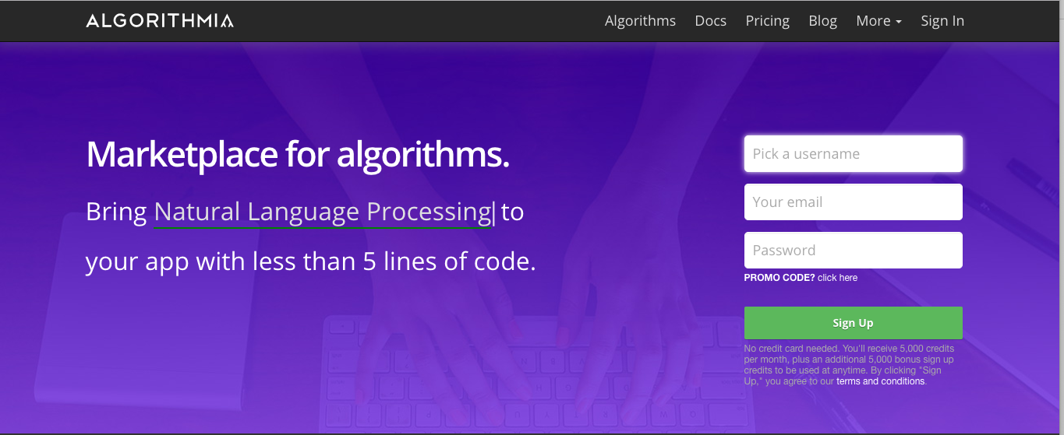
MACHINE LEARNING AS A SERVICE (MLaaS)

Slide 30
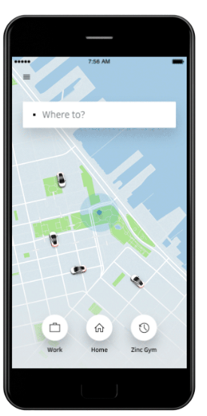
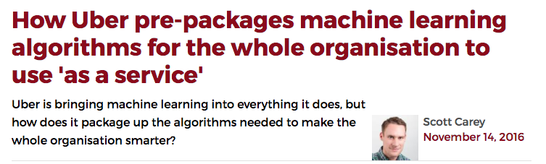
PRE-PACKAGE ALGORITHMS: INTERN MLaaS
The new app Uber starts simply by asking for your destination, including a number of predictions based on your habits and your current location.
Uber is also using machine learning algorithms layered on top of their historic trip data to make more accurate estimated time of arrival.
Uber says it is using machine learning to best predict where you are going before you even open the app
« Uber had machine learning for a while but it is something that can be really hard for software engineers to get. So we have created machine learning-as-a-service inside the company as a cloud service. » Uber Chief Data Scientist

Slide 31

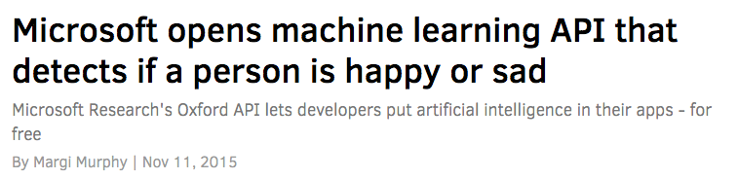
TAP INTO THE OPEN-SOURCE AI
Google opened TensorFlow to the entire world.
Any individual, company, or organization could build their own AI applications using the same software that Google does to fuel everything from photo recognition to automated email replies.
Startups or businesses without the budgets or skills to develop their own machine learning can tap into the API and start training the system to recognise traits from photographs of human faces.

Slide 32
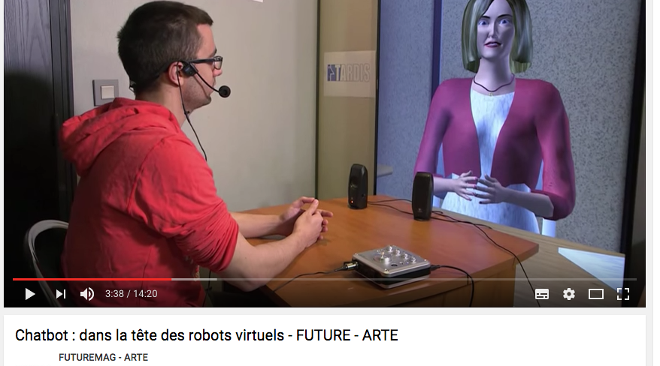
INNOVATE : THE BOTS BOOMING
In July 2016, Microsoft CEO Satya Nadella said that chatbots will “fundamentally revolutionize how computing is experienced by everybody.”
Nadella explained that for now, bots will augment apps, but in time, human language will be taught to all computers and become “the new interface.”

Slide 33
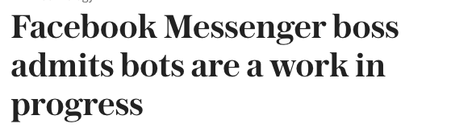
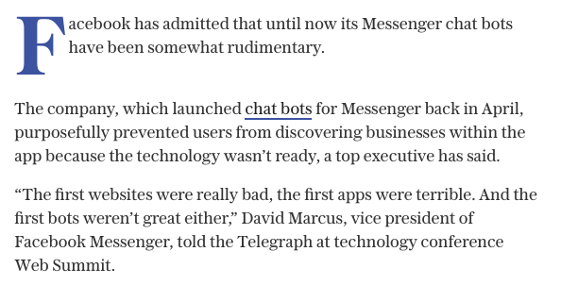
FACEBOOK MESSENGER BOTS
Since April 2016, Bots are available for Facebook's Messenger app, which has 900 million users, and will perform simple tasks that includes acting like a customer service rep, where you text your question instead of talking to someone on the phone.
The platform is powered largely by Facebook’s Applied Machine Learning team and Wit.ai, a startup the social media giant acquired in 2015.
September 2016, the Facebook Messenger team announced that it’s working with several partners to make payments within Messenger bots.

Slide 34

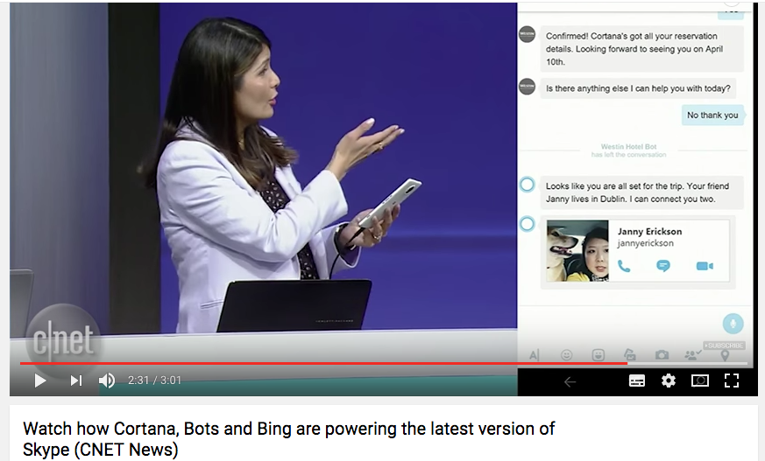
MICROSOFT BOTS FRAMEWORK
More than 45,000 developers are now using the Microsoft Bot Framework versus 34,000 developers on Facebook’s Mensenger.
Skype chatbots can now now be part of group chats and respond to messages from multiple users in a single chat, potentially making interaction with the Skype bot framework much more like the group experience on Slack.
Microsoft announced plans to incorporate Cortana or text chatbots into Office 365 email, Skype, and several other applications.

Slide 35
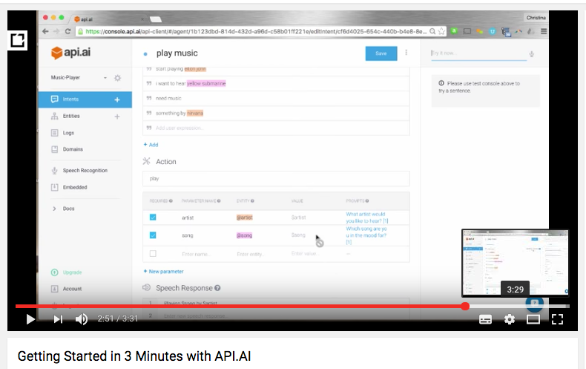
GOOGLE : THE NEW POWERFUL BOTS PLAYER
September 2016, Google made the acquisition of API.ai.
60,000 developers are using Api.ai to build conversational experiences, for environments such as Slack, Facebook Messenger and Kik. .
Google also launched Google Allo, a messaging app for Android and iOS with Smart Reply and Google Assistant.

Slide 36
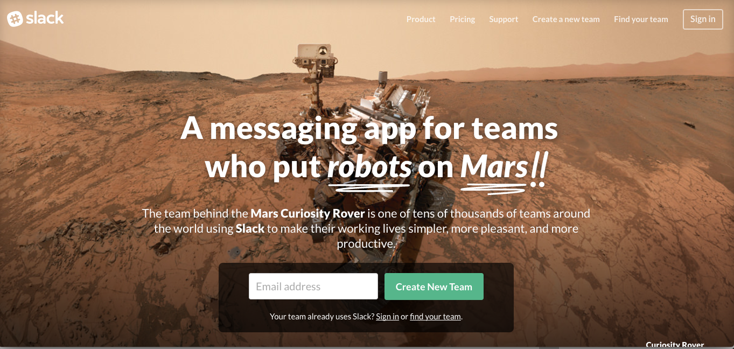
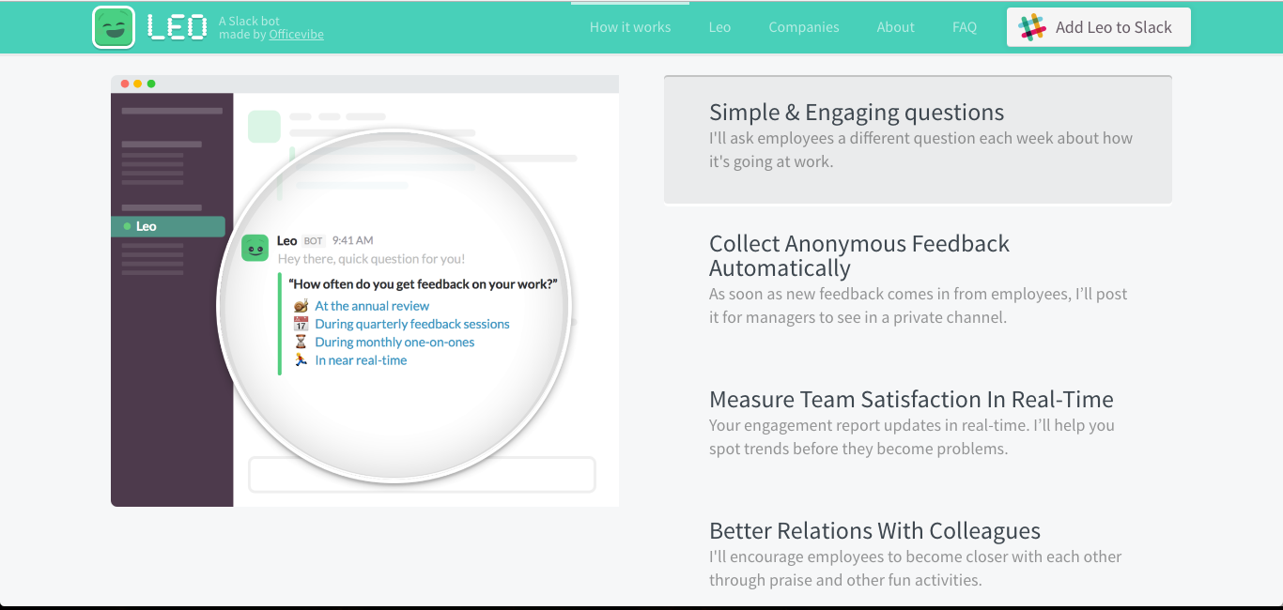
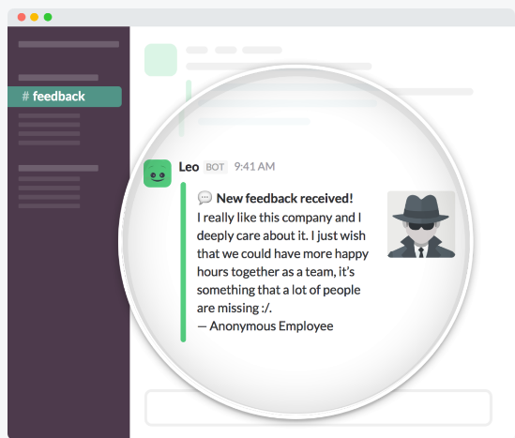
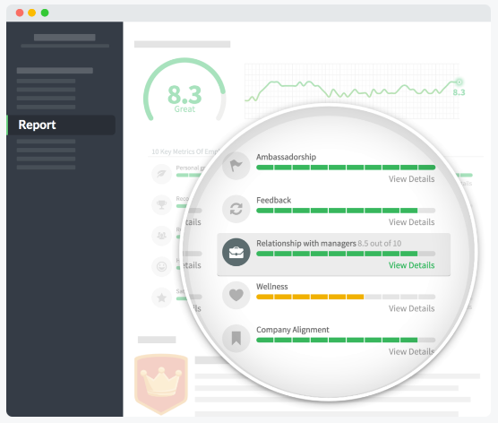
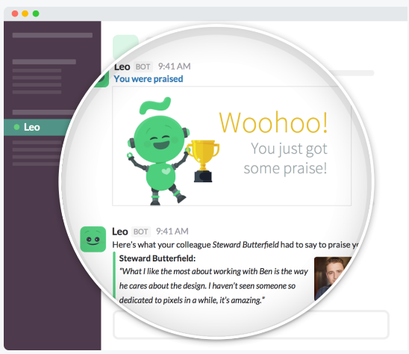
SLACK : LEO THE BOT MANAGER

Slide 37
IMPACTS ?

Slide 38
IMPACT ON E-COMMERCE
Visual search.
Software platforms that drive e-commerce websites are creating visual search capabilities which allow consumers to upload an image and find similar/complementary products.
Offline to online worlds merge.
Shopping in the future will use AI to gather information you’ve posted on the website, such as a product review, to service you in their brick-and-mortar counterpart better and make suggestions accordingly.
Personalization.
Personalization in ecommerce is nothing new. But thanks to emerging AI technologies, online brands of all sizes will have increasing access to tools laser-focused on personalization.
Virtual personal shopper
A growing number of e-commerce stores integrating sophisticated AI technologies specific to their online store to shop on behalf of users.

Slide 39

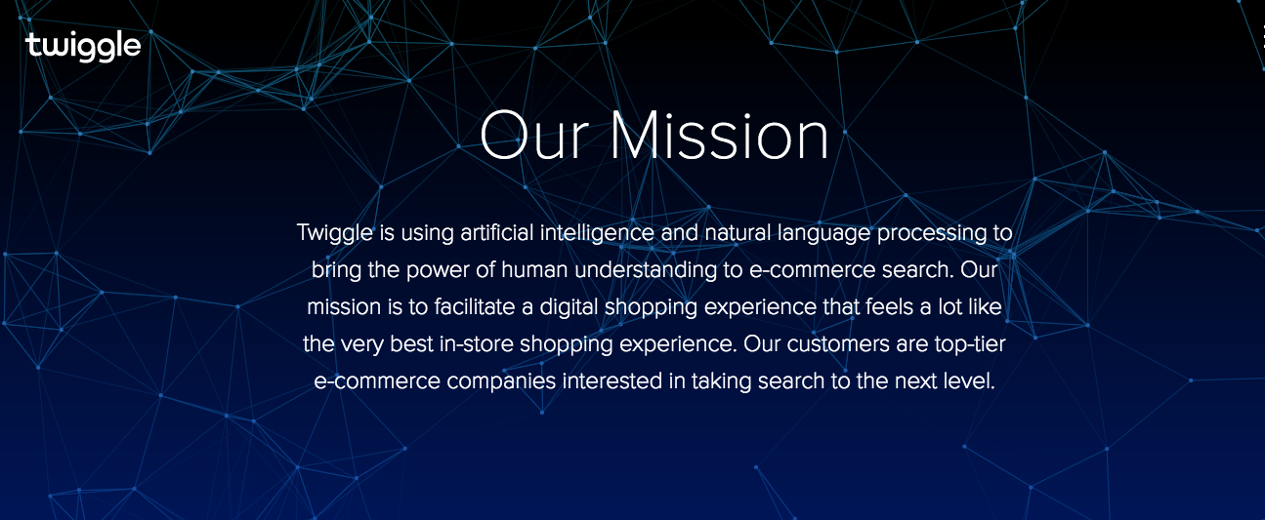

IMPACT ON E-COMMERCE : TWIGGLE
May 31, 2016 BEIJING—Chinese Internet giant Alibaba Group Holding Ltd. is investing in an Israeli technology company that aims to improve product searches on e-commerce websites.

Slide 40

IMPACT ON E-COMMERCE: STAPLES
Staples is taking advantage of cognitive computing in its “Easy Button ».
Enabling small and medium businesses to transform how they shop for everything they need for their offices.
The Staples Easy System integrates IBM Watson technology.
Simplify office supply management for its Staples Business Advantage Customers and brings the “on-demand” world to businesses.
Allowing customers to order anytime, anywhere, from any device they prefer.

Slide 41
IMPACT ON COMMERCE : THE BOT-COMMERCE
Bots making offers – The customer makes an inquiry about a service and the bot responds by providing the customer with a time sensitive offer.
Bots acting as a ‘knowledgeable friend’ – Online stores are useful but often customers want to know more information than can be conveniently displayed. A bot would be an ideal way for a customer to find out more about the product (product specifications, the terms of the warranty etc)
A bot to locate your nearest store –A bot could be used to tell you where your nearest store is, and potentially offer you directions to the store.
A bot to upsell products – When a customer makes a purchase there are often complementary items which customers may like to purchase alongside the product.
A bot to follow up with customers – The greater the understanding a business has of their customers habits and behaviour the more effective a bot can be. Imagine having a bot that was able to reach out to customers and ask: “How are you getting on looking for your new TV? Let me know if I can help”.

Slide 42
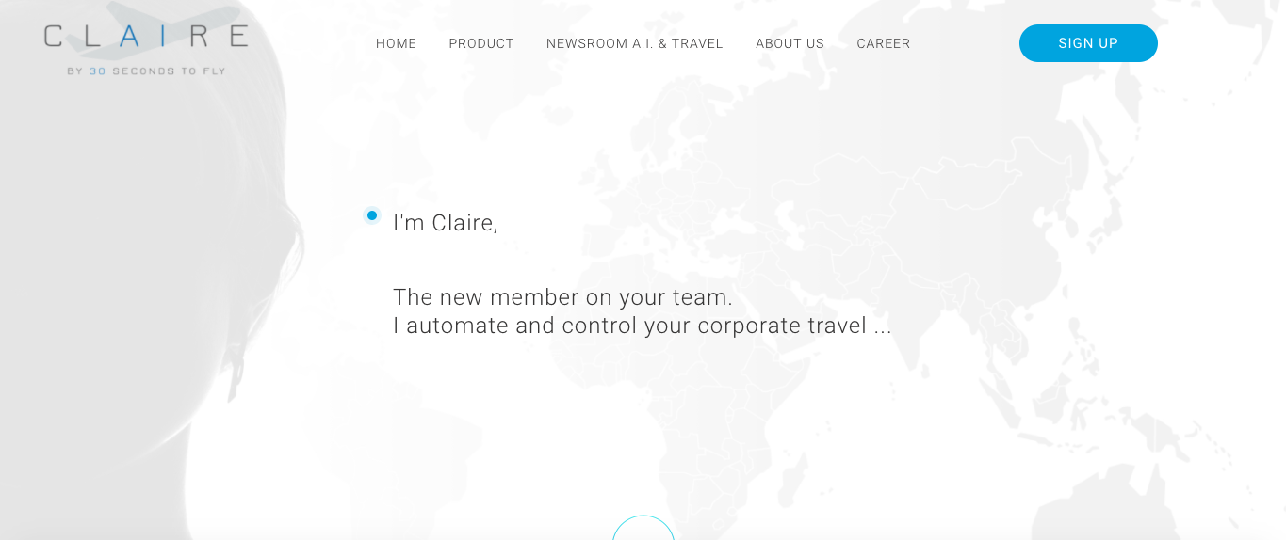
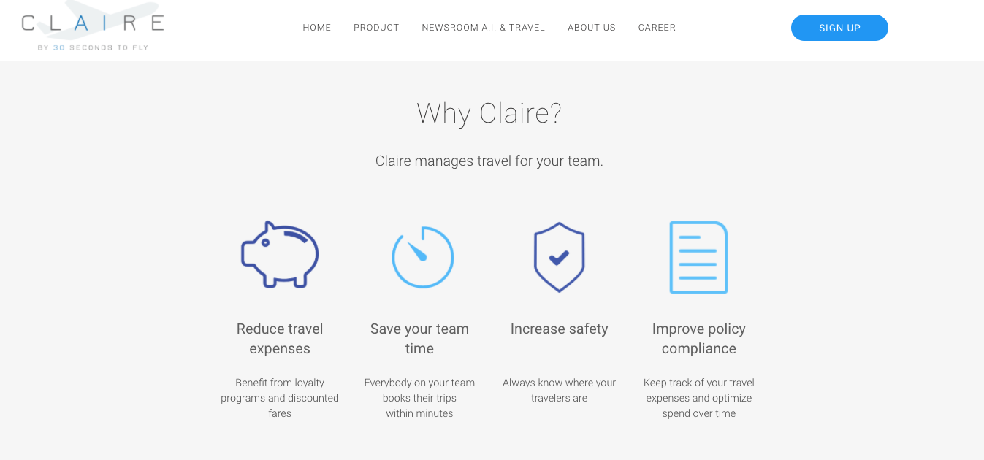
EMERGENCE OF COGNITIVE BUSINESS (BtoB)
For smaller companies, there are very limited possibilities to manage their travel efficiently while making the return on ROI work out.
Smaller companies don’t manage their travel require their employees to manage their own travel, using Expedia and the likes. This creates challenges to the employer, which include: lack of transparency, inability to analyze data, inability to lower travel expenses systematically and so on.
Claire AI travel assistant platform helps address all of these challenges.

Slide 43
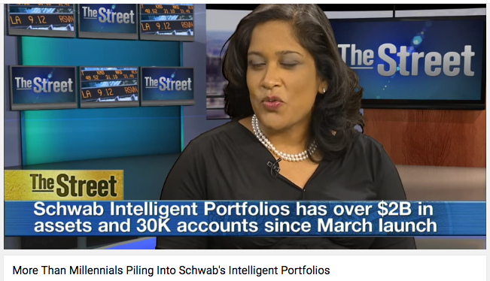
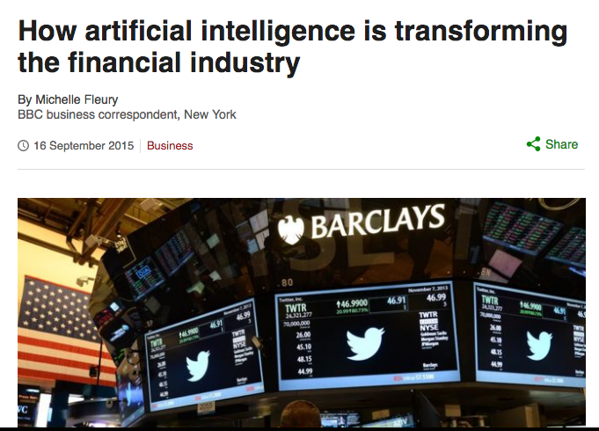

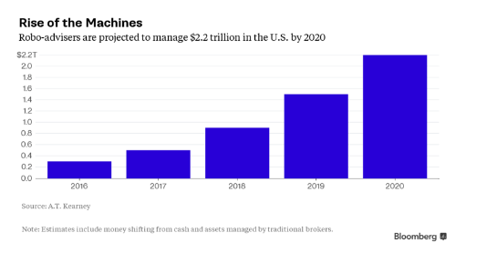
IMPACT ON THE FINANCIAL INDUSTRY
In March 2015, Charles Schwab launched a new service called Schwab Intelligent Portfolios : https://goo.gl/PVy48G
The service is unique in that it's not a person who decides where to invest money, it's an algorithm - lines of code programmed into a computer.
Schwab Intelligent Portfolios has 54 exchange-traded funds covering 20 asset classes. Stocks, bonds, commodities, emerging markets, and REITs are all available through this program.

Slide 44
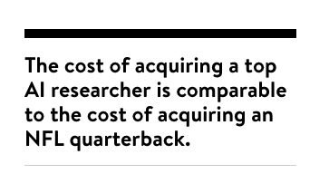
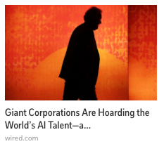
IMPACT ON WORKFORCE
New skills needed :
Various level of math, including probability, statistics, algebra, calculus, logic and algorithms.
Physics, engineering and robotics.
Computer science, programming languages and coding.
Cognitive science theory.
Experience in deep neural networks and software like Google open source TensorFlow Engine.
New Job Opportunities :
AI Researchers.
Software analysts and developers.
Computer scientists and computer engineers.
Algorithm specialists.
Research scientists and engineering consultants.
Mechanical engineers and maintenance technicians.
Manufacturing and electrical engineers.
Surgical technicians working with robotic tools.
Medical health professionals working with artificial limbs, prosthetics, hearing aids and vision restoration devices.
Military and aviation electricians working with flight simulators, drones and armaments.

Slide 45


IMPACT ON JOBS
Natural language generation will replace Data Analyst ?

Slide 46


IMPACT ON MANAGEMENT
AI will shift focus from coordination and control to judgment work, such as strategy and innovation, collaboration, people and community.
Accenture survey 2016

Slide 47



IMPACT ON MANAGEMENT : GLURU

Slide 48

IMPACT ON COMPETITIVENESS
Over in Europe, London is still considered the continent’s leading AI hub.
Between January 2014 and mid-October 2016 : 111 AI-related companies in the U.K. raised $342 million in venture capital.
Google acquired London based DeepMind in January 2014.
June 2015, Facebook announced it was opening its global AI reasearch center in Paris.
June 2015, Facebook acquired Wit.ai a start-up created by French gratuates of Paris Ecole Polytechnique.
Japan’s ecommerce leader Rakuten has opened an AI research center in France.
June 2016, GE opened its Digital Foundery in Paris to develop Predix.

Slide 49


IMPACT ON REGULATION
Establish flexible frameworks that ensure safety while encouraging innovation.
USA. August 2016. For the first time, the rule authorizes widespread non-recreational flights of UAS under 55 pounds.
The rule limits flights to daytime, at an altitude of 400 feet or less, with the vehicle controlled by a licensed operator and within the operator’s direct line of sight.
Flights over people are not allowed.
Ideally, every student learning AI, computer science, or data science would be exposed to curriculum and discussion on related ethics and security topics

Slide 50







IMPACT ON WORLD ECONOMIC LEADERSHIP
Since mid-2013 China has been contributing more journal articles to the field of deep learning research and has more studies cited by other researchers than the US.
In 2015, Chinese researchers published around 350 articles, compared to around 260 in the US.
When AI stands to transform virtually everything including labor, the environment, and the future of warfare and cyberconflict, the United States could be put at a disadvantage if other countries, such as China, get to dictate terms instead.

Slide 51


